Slide 1
Samuel Rodriguez
HikeVA

Slide 2
Project
Physically active people who like the outdoors
Lets users know all essentials details of a hiking trail around Northern Virginia
Lets users get an idea of how the trail looks like and where it is located

Slide 3
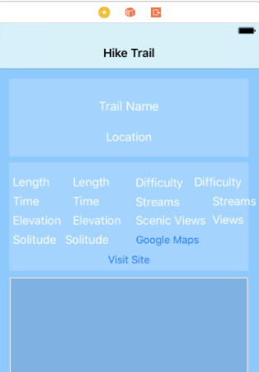
Learned
How to correctly size pictures for ImageViews
How to make a gradient background
Format label font
Work with alpha values of labels

Slide 4
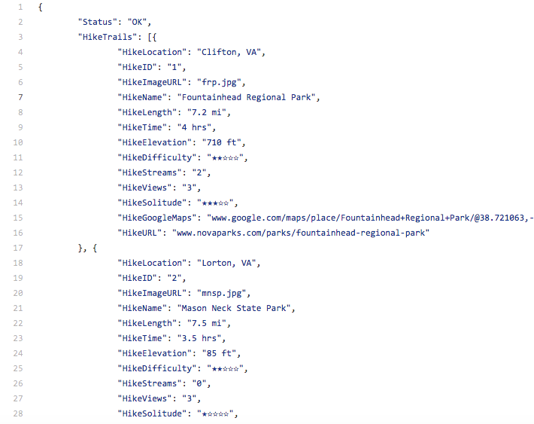
Challenges
Pictures from URL via JSON
Master View Controller UI design
Format label font
JSON File

Slide 5
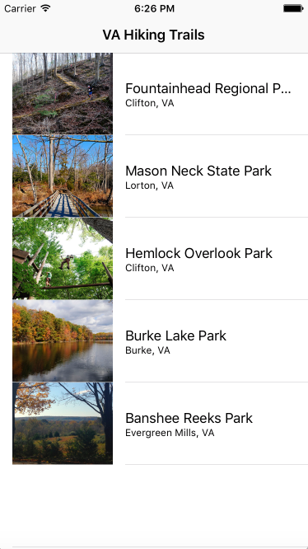
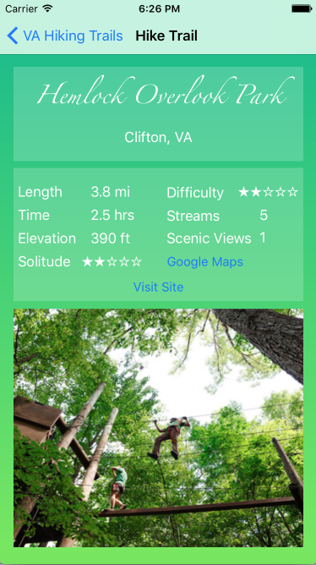
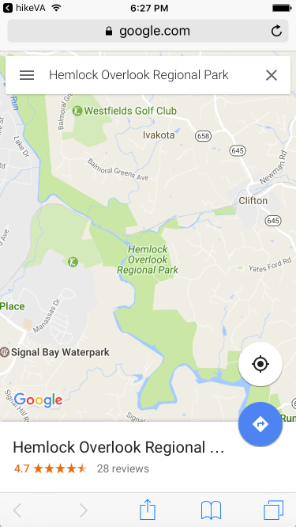
Screenshots

Slide 6
Next Steps
Array of pictures for each park
Current weather data for each park
PDF Hiking trail maps
Social Networks integration

